Slide 1
Follow Me 2
Shuai Fu
25 Mar. 2017

Slide 2
Agenda
Design
Security Properties
Implementation
Limitations and future work
Source Code
Demo

Slide 3
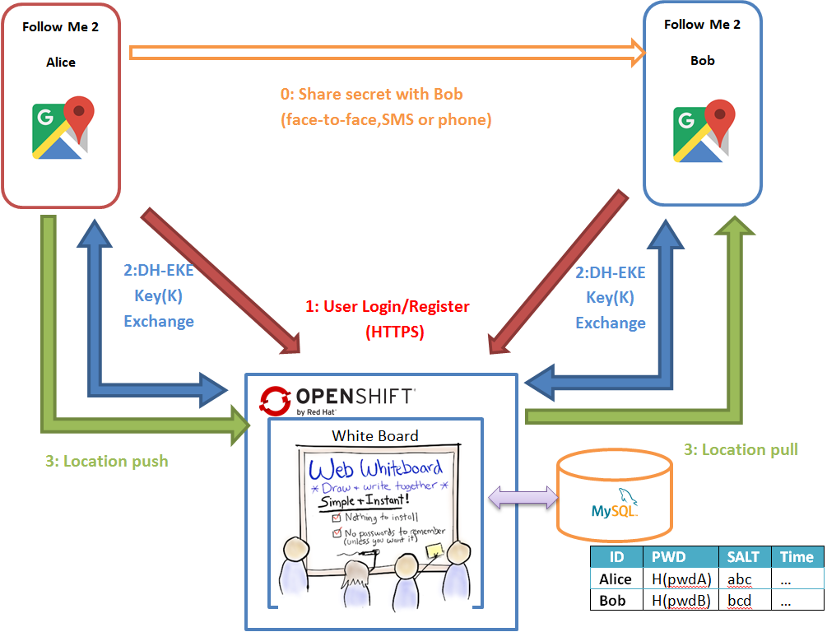

Design

Slide 4
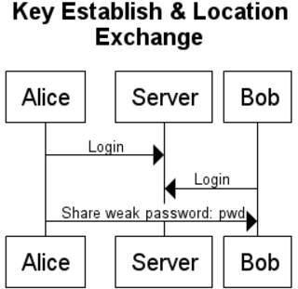
Design
Web Server(WhiteBoard)
Leader Key Map
ID | E(PubK)
Follower Key Map
To | From | E(PubK)
Pushed Location Map
To | From | E(GPS)

Slide 5
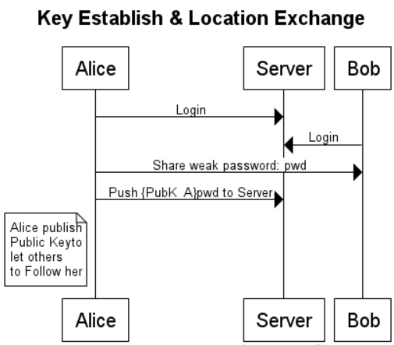
Design
Web Server(WhiteBoard)
Leader Key Map
ID | E(PubK)
Alice | {PubK_A}pwd
Follower Key Map
To | From | E(PubK)
Pushed Location Map
To | From | E(GPS)

Slide 6
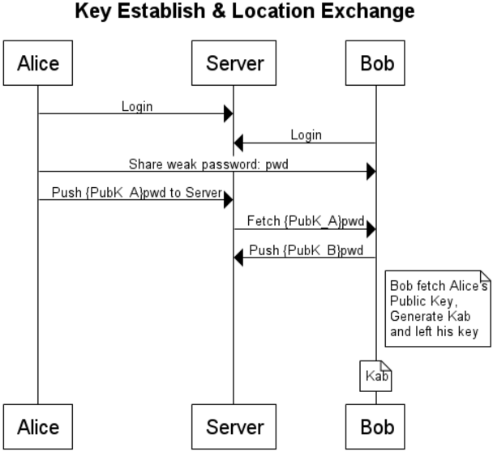
Design
Web Server(WhiteBoard)
Leader Key Map
ID | E(PubK)
Alice | {PubK_A}pwd
Follower Key Map
To | From | E(PubK)
Alice | Bob | {PubK_B}pwd
Pushed Location Map
To | From | E(GPS)

Slide 7
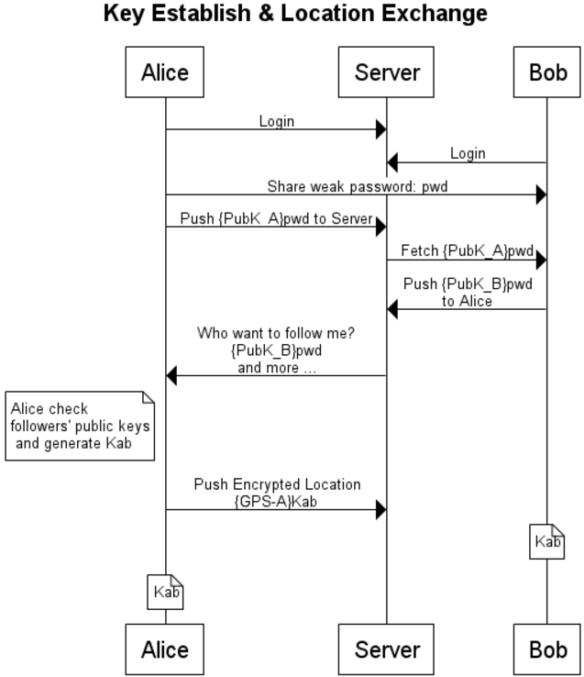
Web Server(WhiteBoard)
Leader Key Map
ID | E(PubK)
Alice | {PubK_A}pwd
Follower Key Map
To | From | E(PubK)
Alice | Bob | {PubK_B}pwd
Pushed Location Map
To | From | E(GPS)
Bob | Alice | {GPS-A}Kab

Slide 8
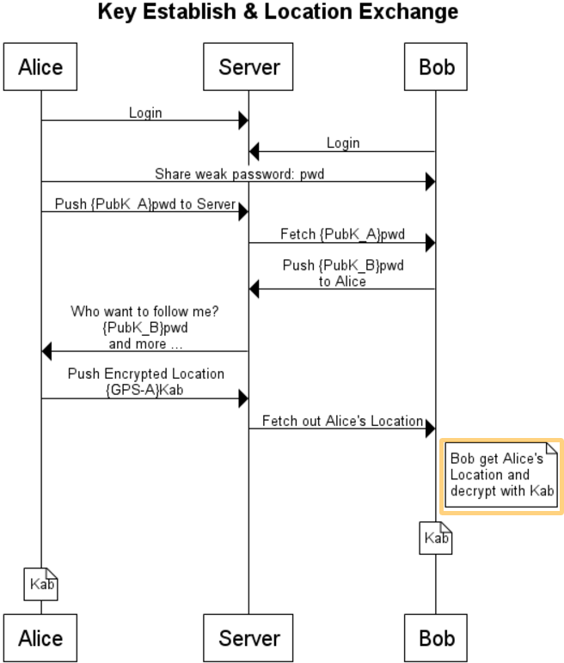
Web Server(WhiteBoard)
Leader Key Map
ID | E(PubK)
Alice | {PubK_A}pwd
Follower Key Map
To | From | E(PubK)
Alice | Bob | {PubK_B}pwd
Pushed Location Map
To | From | E(GPS)
Bob | Alice | {GPS-A}Kab

Slide 9
Design
Pull/Push-based lightweight Client-Server Design
No long-connection between C/S (HTTPS)
Standard Web App (No socket permission needed)

Slide 10
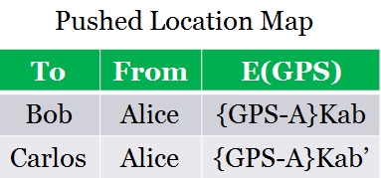
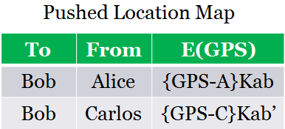
Design
Asynchronized Key/Location Exchange
One-HTTPS-push-serve-many
Non-blocking communication (no availability assumption between clients).
Support many-to-many Location Exchange

Slide 11
Agenda
Design
Security Properties
Implementation
Limitations and future work
Source Code
Demo

Slide 12
Security Properties
Diffie-Hellman Encrypted Key Exchange (DH-EKE)
Always Encrypted Location Information
Minimum Personal Information Required
OpenShift Proxy
Always HTTPS
Always Tor

Slide 13
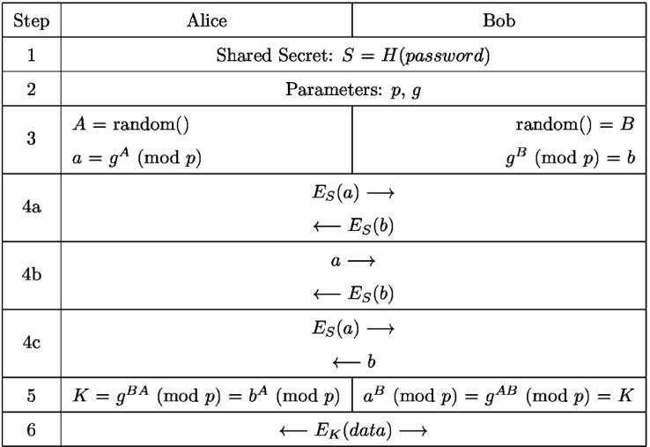
Security Properties
Diffie-Hellman Encrypted Key Exchange

Slide 14
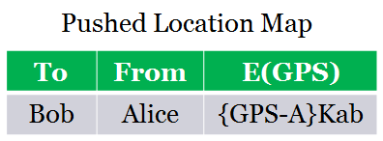
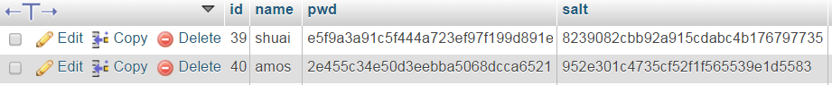
Security Properties
Encrypted Location Information
Location information stored in Server side is cipher
Minimum Personal Information Required
Only ID and password needed
Salted Password Hashing

Slide 15
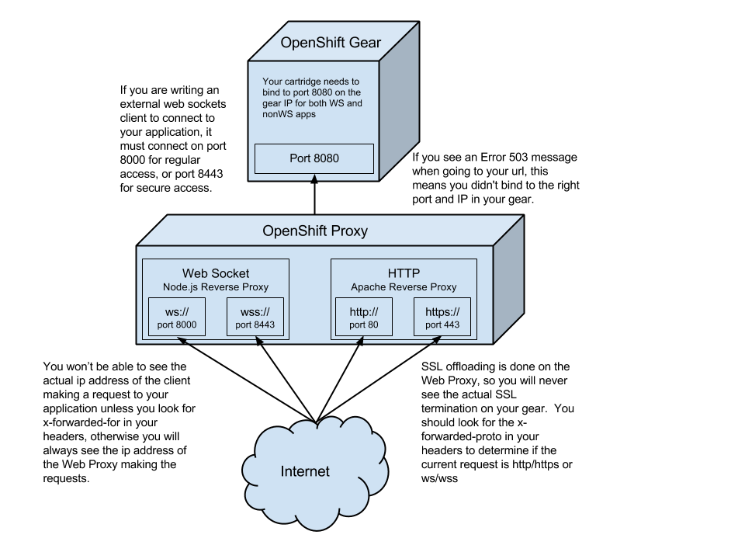
Security Properties
OpenShift Proxy

Slide 16
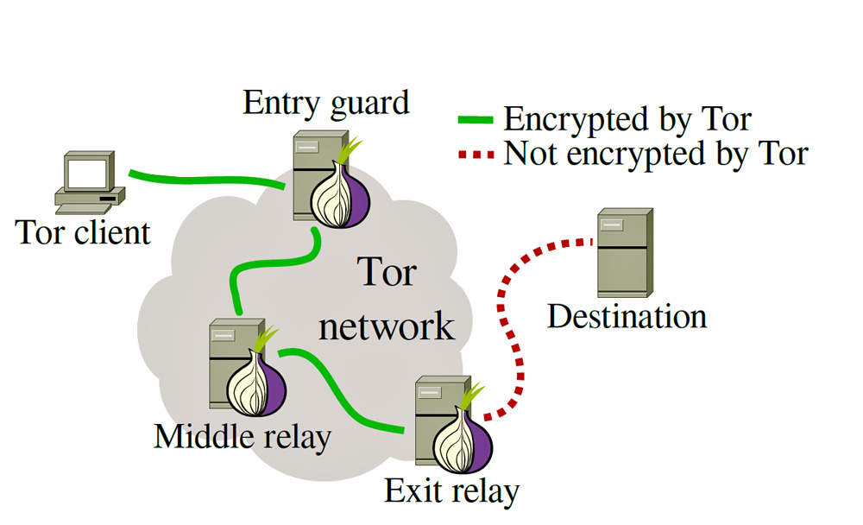
Security Properties
Tor Network
“The Onion Router”

Slide 17
Agenda
Design
Security Properties
Implementation
Limitations and future work
Source Code
Demo

Slide 18
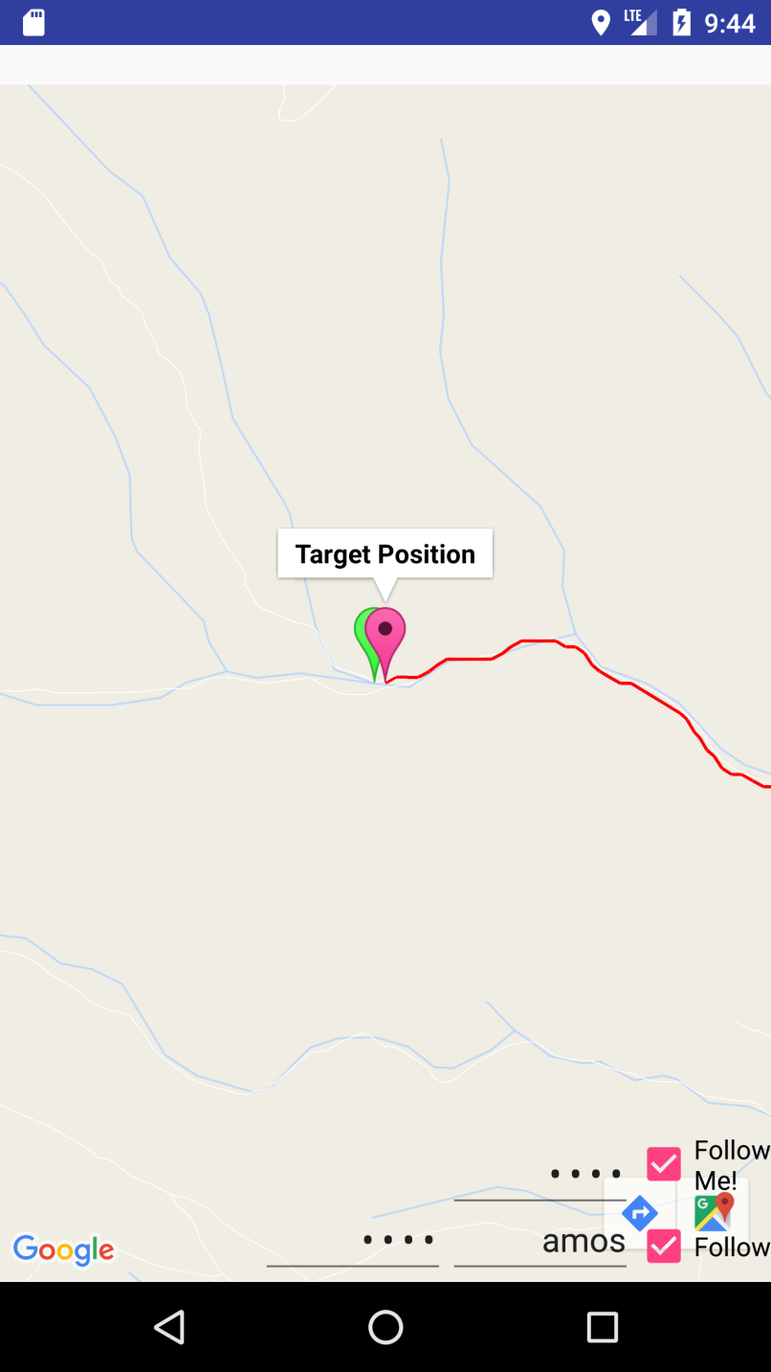
Implementation
Google Map API V2
Zero configuration
One-click operation
Target trace
Online/offline notify
Auto-installation of Tor

Slide 19
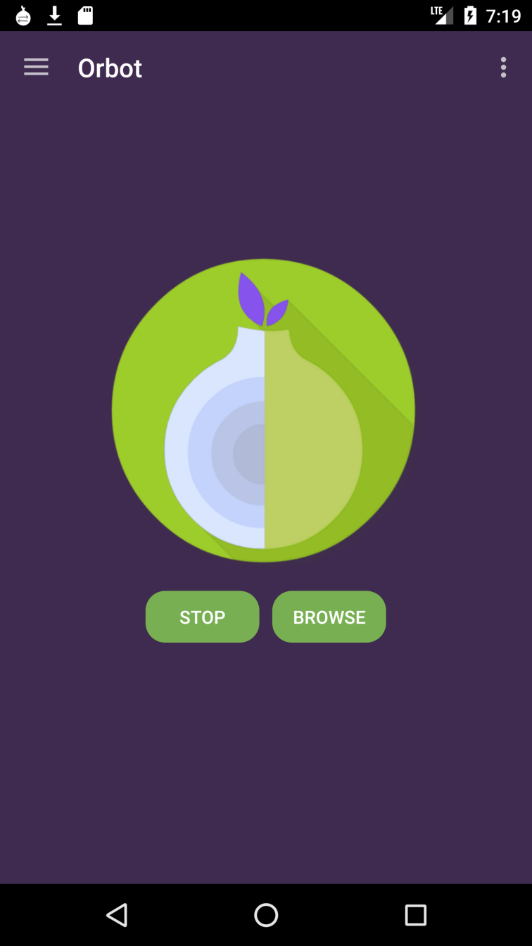
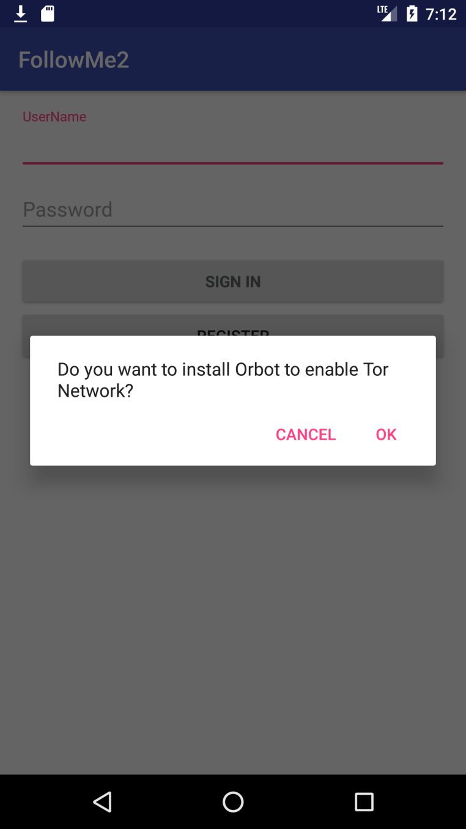
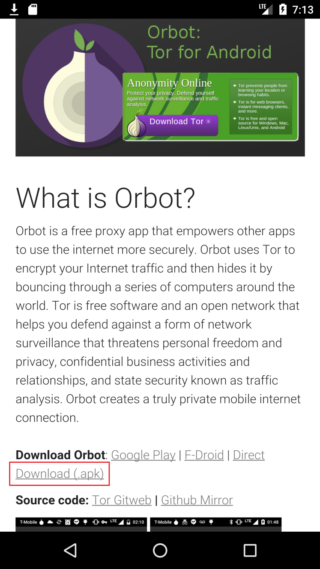
Implementation
Auto-installation of Tor
Orbot + Netcipher

Slide 20
Agenda
Design
Security Properties
Implementation
Limitations and future work
Source Code
Demo

Slide 21
Limitations and Future Work
Battery life
Frequency of GPS checking
Orbot Tor Client
Screen-on
Configurability (add settings)
Tor TLS proxy Interception problems

Slide 22
Agenda
Design
Security Properties
Implementation
Limitations and future work
Source Code
Demo

Slide 23
Source Code
FollowMe2
https://github.com/amosfu/FollowMe2
Whiteboard2
https://github.com/amosfu/whiteboard2

Slide 24
Agenda
Design
Security Properties
Implementation
Limitations and future work
Source Code
Demo

Slide 25

Demo

Slide 26
Thank you !

